Slide 1
BANK LOAN CASE STUDY
Shivam Singh

Slide 2
Project Description
1. Risk Analytics Focus: Identify patterns indicating potential loan repayment difficulties to assist financial institutions in making informed loan approval decisions.
2. Missing Data Handling: Detect and appropriately manage missing data in the loan dataset using Excel functions like `COUNT`, `ISBLANK`, and imputation techniques.
3. Outlier Detection: Identify and analyze outliers using statistical measures such as IQR and visualize them with box plots to ensure data accuracy.
4. Data Imbalance Analysis: Assess and visualize data imbalance in the target variable to understand class distribution and its impact on analysis.
5. Variable Analysis: Conduct univariate, segmented univariate, and bivariate analyses to explore variable distributions and relationships with loan default risks.
6. Correlation Identification: Identify top correlations between variables and loan defaults, segmenting data to highlight key indicators for better risk management decisions.
Python Link : https://drive.google.com/file/d/1WCZDZ095guPWsOTSn_00yaPDLknMxCKc/view?usp=sharing

Slide 3
Approach
To prepare the dataset for analysis in Python, the first step is to clean and ready the data by identifying and handling missing values using methods such as imputation or removal. Next, outliers are detected and managed to prevent skewing results. Imbalanced data, if present, is addressed using techniques like resampling or weighting. Univariate analysis is then conducted to understand individual feature distributions, followed by bivariate analysis to examine relationships between pairs of variables. Finally, multivariate analysis helps identify top correlations, allowing for deeper insights into the data and ensuring a robust foundation for predictive modeling.
Video presentation Link: https://drive.google.com/file/d/17jfyp7VY7hNWllRn_EAnrGW4YZEqwxm_/view?usp=sharing

Slide 4
Tech-Stack Used
Microsoft Excel
We use excel to read and convert
The data according to our needs.
Python
Python is used for analyzing and gaining insights to complete project task.
Jupyter Notebook
Jupyter is used to write and execute Python code to gain insights.
Microsoft PowerPoint
PowerPoint used to create reports and present visualized insights.

Slide 5
Tech-Stack Used
A. Identify Missing Data and Cleaning
B. Identify Outliers in the Dataset
C. Analyze Data Imbalance
D. Perform Univariate and Bivariate Analysis
E. Identify Top Correlations for Different Scenarios

Slide 6
Insights

Slide 7


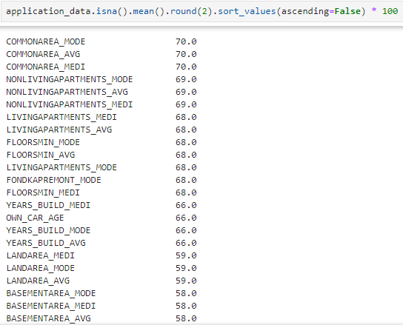
A. Identify Missing Data and Cleaning
Dataset 1 :- application_data.csv
Number of rows
49999
Number of columns
122
Total count of columns that have null cell : 67
The total number of columns that have at least one null cell is 67. Below is a sorted list of these columns, showing the percentage of null values relative to the total cells in each column. Since more than 50% of the columns contain null values, we set a threshold of 40% to drop columns with a high percentage of missing data.

Slide 8
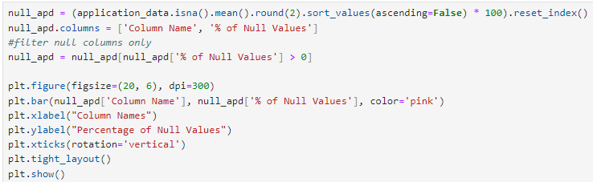
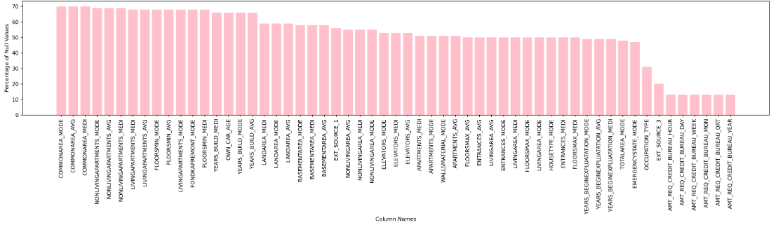

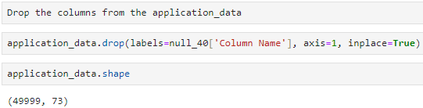
"A threshold of 40% null values was set to drop columns, resulting in a total of 49 columns being dropped."

Slide 9
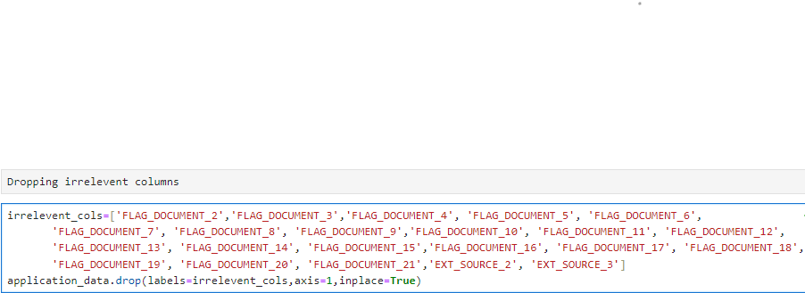
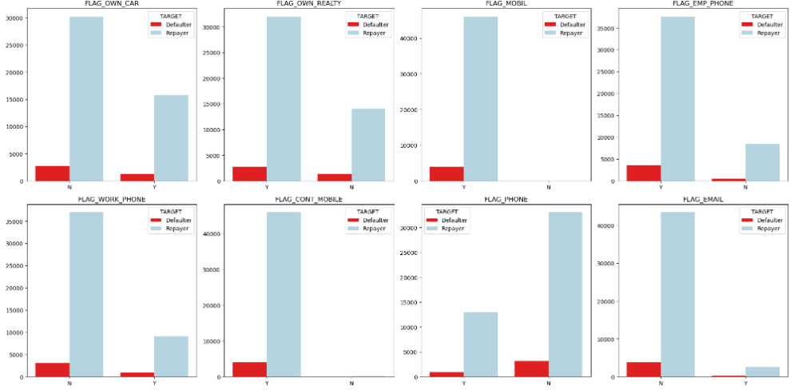
"Now, 22 irrelevant columns that are not used in the analysis have been dropped."
So, after this, these columns can be dropped as they will no longer be used.

Slide 10
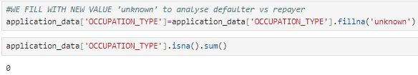
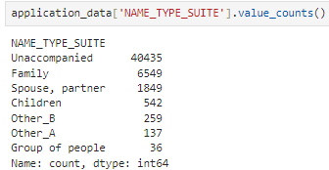

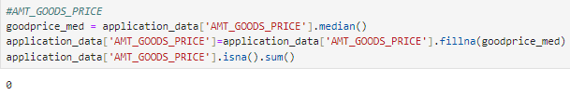

Data Imputation - Dataset 1 :- application_data.csv
In data imputation, there are some columns that still contain null values. For example, in the 'Occupation Type' column, 31.4% of the values are null, so we will replace them with 'Unknown', as this category has type so use a new to analysis. Similarly, in the 'Name Type Suite' column, the missing values will be replaced with 'Unaccompanied', highest frequency of the data. For other numerical columns, such as 'AMT_REQ_CREDIT_BUREAU_YEAR', the missing values will be replaced with the median value, which in this case is 1000.
Group the 'AMT_REQ_CREDIT_BUREAU' columns together and fill the missing values with the median at once. Similarly, group the 'Social Circle' columns and fill the missing values with the median. For other groups like 'AMT Group', 'Price', and 'AMT_ANNUITY', replace the missing values separately
No duplicate data found in dataset application_data

Slide 11
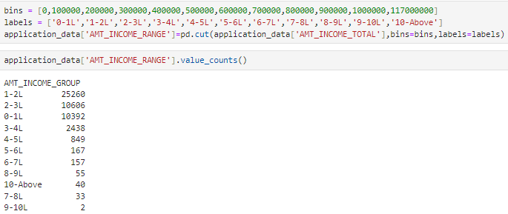
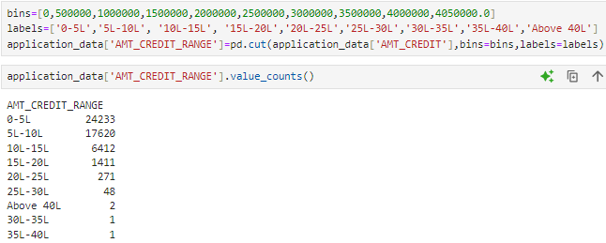
Data Standardization - Dataset 1 :- application_data.csv
For data standardization, binning is applied to numerical columns to create categorical columns by defining bins and labels. This process creates a range of values and converts them into categorical data types.
AMT_INCOME_TOTAL' is categorized into ranges from 0 to 10 lakhs with a gap of 1 lakh, and values above 10 lakhs are grouped together by creating bins and labels. Similarly, 'AMT_CREDIT' is binned to create categorical data, which will be used for later analysis.

Slide 12
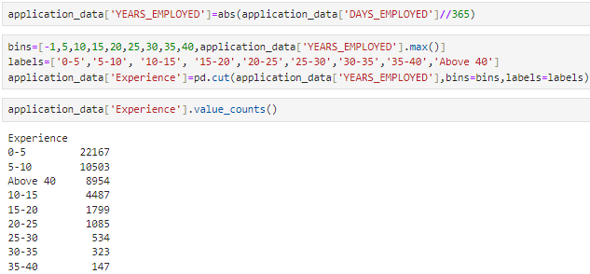
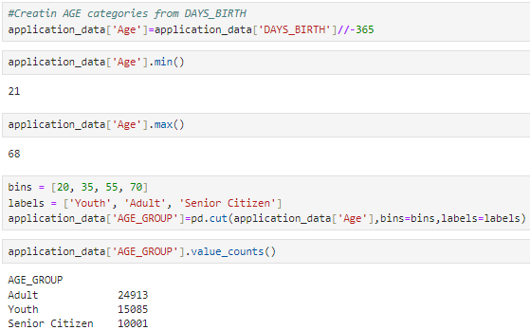
To create 'Years Employed' from 'DAYS_EMPLOYED', take the absolute value of 'DAYS_EMPLOYED', divide by 365, and create bins for 0 to 40 years in 5-year intervals. This will categorize years of employment for analyzing loans by employed individuals
To create age categories, we divide ages into three groups: Young (20-35), Adult (35-55), and Senior Citizen (55-70). After categorizing, we can analyze whether the majority of loans are taken by adults, followed by young individuals.

Slide 13

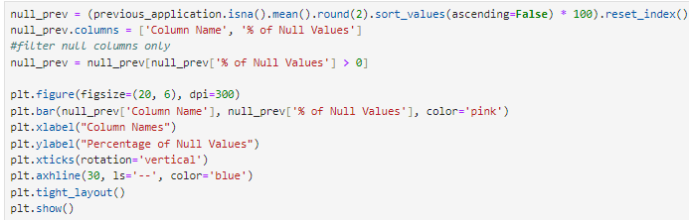
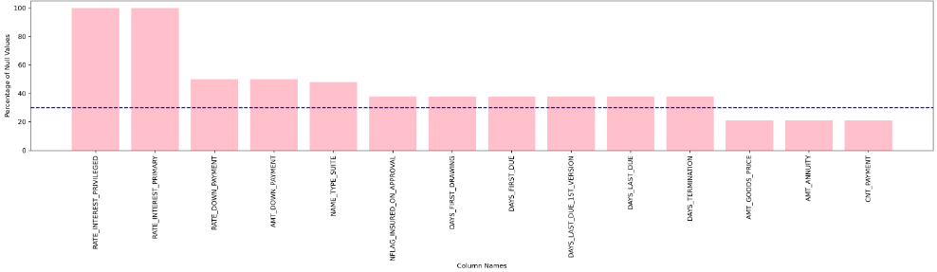
Dataset 2 :- previous_application.csv
Now, the focus is on the previous_application dataset to identify missing values, remove irrelevant columns, perform data imputation, and standardize the dataset.
Number of rows
49999
This chart shows the percentage of null values in each column. The blue line indicates a 30% threshold, above which columns will be dropped to create a clean dataset.
Number of columns
37

Slide 14
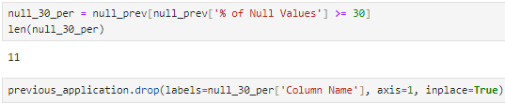
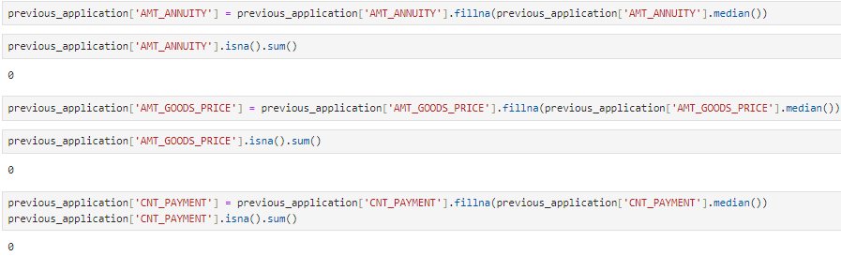
So, in this code, 11 columns that have more than 30% null values are dropped.
Removing 5 irrelevant columns from dataset
Data Imputation - Dataset 2 :- previous_application.csv
In the Data imputation process, the remaining columns with missing data are filled with appropriate values
Imputing the columns AMT_ANNUITY, AMT_GOODS_PRICE, and CNT_PAYMENT with their respective median values

Slide 15
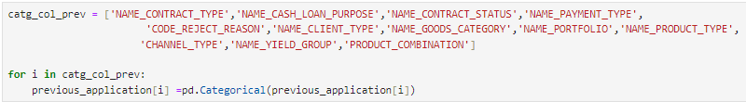
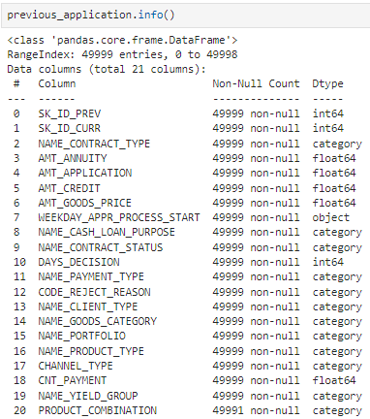
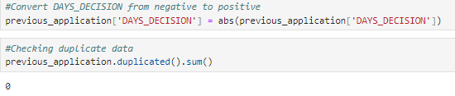
After cleaning the dataset and handling duplicates, necessary columns are converted into categorical data types to better represent their values. With no missing values or duplicates, the dataset is now fully prepared for further analysis, ensuring accurate insights and optimized model performance.

Slide 16
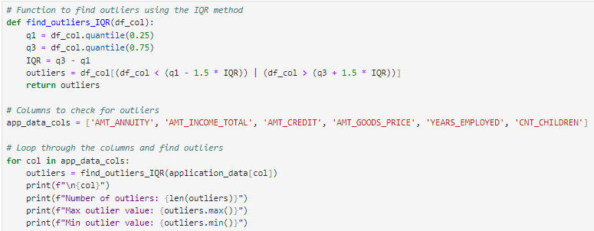
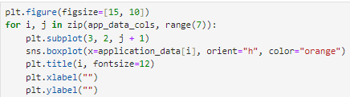
B. Identify Outliers in the Dataset
Dataset 1 :- application_data.csv
This code defines a function to identify outliers and then iterates over a group of columns to get the number of outliers, as well as the maximum and minimum outliers for each column. It then creates a boxplot for each set of outliers to visualize them more easily.

Slide 17
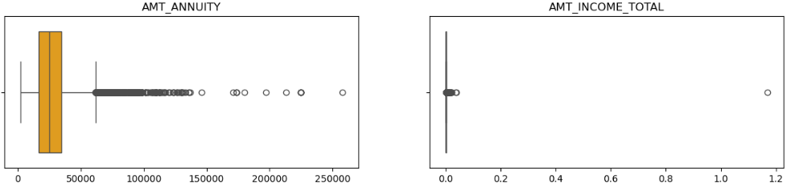
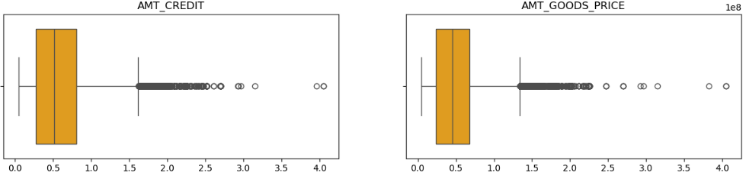
AMT_ANNUITY
AMT_INCOME_TOTAL
Number of Outliers
1188
Number of Outliers
2295
Max Outlier Value
258025.5
Max Outlier Value
117000000
Min Outlier Value
61875.0
Min Outlier Value
338746.5
AMT_CREDIT
AMT_GOODS_PRICE
Number of Outliers
1063
Number of Outliers
2387
Max Outlier Value
4050000
Max Outlier Value
4050000
Min Outlier Value
1620000
Min Outlier Value
1345500

Slide 18
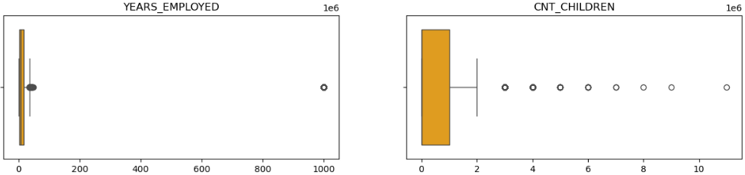
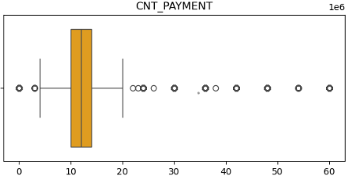
YEARS_EMPLOYED
CNT_CHILDREN
Number of Outliers
9101
Number of Outliers
723
Max Outlier Value
1000
Max Outlier Value
11
Min Outlier Value
36
Min Outlier Value
3
Dataset 2 :- previous_application.csv
CNT_PAYMENT
Number of Outliers
14011
Max Outlier Value
60.0
Min Outlier Value
0.0

Slide 19
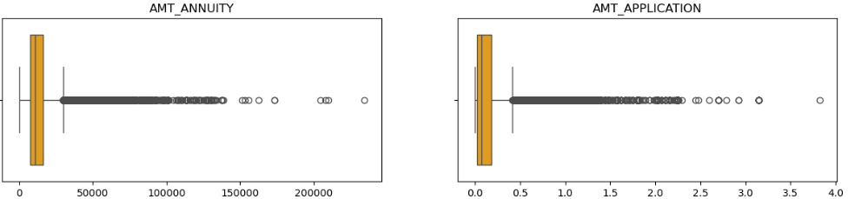
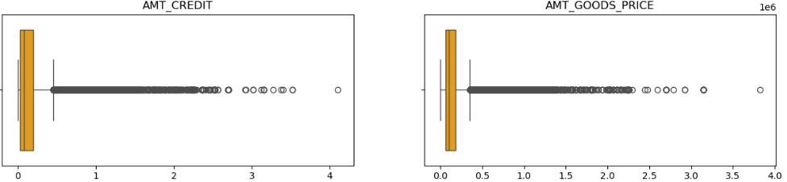
AMT_ANNUITY
AMT_APPLICATION
Number of Outliers
4922
Number of Outliers
5792
Max Outlier Value
234478.4
Max Outlier Value
3826372.5
Min Outlier Value
29869.2
Min Outlier Value
418306.5
AMT_CREDIT
AMT_GOODS_PRICE
Number of Outliers
5648
Number of Outliers
6569
Max Outlier Value
4104351
Max Outlier Value
3826372.5
Min Outlier Value
456507
Min Outlier Value
355050.0

Slide 20
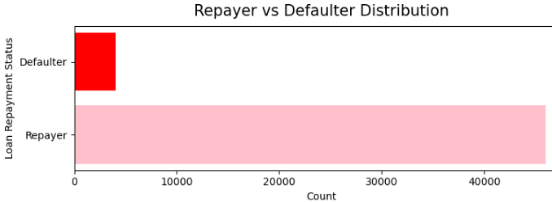
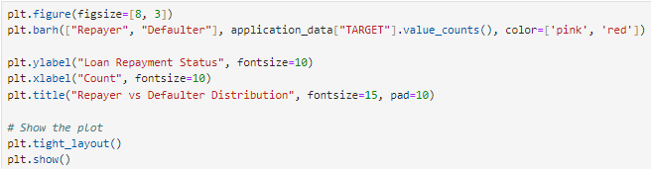
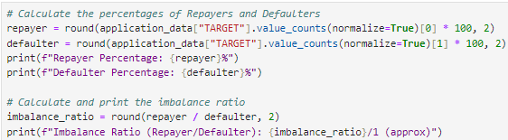
C. Analyze Data Imbalance
No. of Repayer : 45973
No. of Defaulter: 4026
Repayer Percentage: 91.95% Defaulter Percentage: 8.05% Imbalance Ratio (Repayer/Defaulter): 11.42/1 (approx)
The dataset shows a significant imbalance, with 91.95% Repayers and only 8.05% Defaulters, meaning for every 11 Repayers, there is 1 Defaulter.

Slide 21
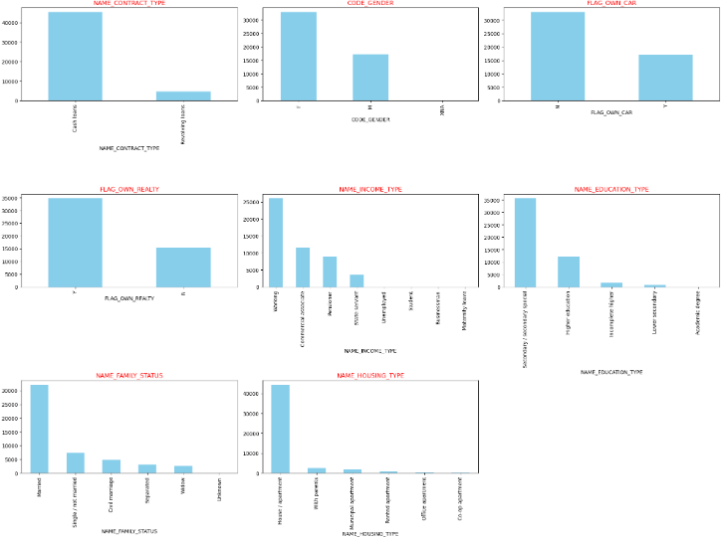
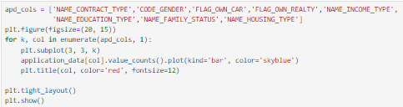
These charts illustrate the data imbalance present in the application dataset. They highlight the uneven distribution of various categories

Slide 22
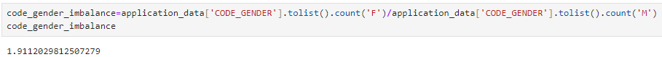
NAME_CONTRACT_TYPE : Cash loans : 45276 Revolving loans: 4723
In the Name Contract Type column, for every 11 cash loans, there is 1 revolving loan, indicating an imbalance.
CODE_GENDER : Female : 32823 Male : 17174 XNA : 2
In the Code Gender column, there is a notable imbalance, with 32,823 females and 17,174 males, showing that nearly twice as many females apply for loans compared to males
FLAG_OWN_REALTY : Yes : 34691 No : 15308
In the Flag Own Realty column, there is a notable imbalance, with 34,691 indicating "Yes" and 15,308 indicating "No," showing that more than twice as many applicants own real estate compared to those who do not.

Slide 23
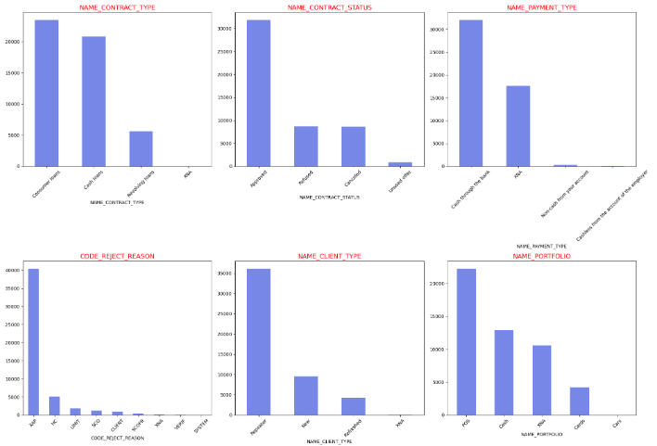
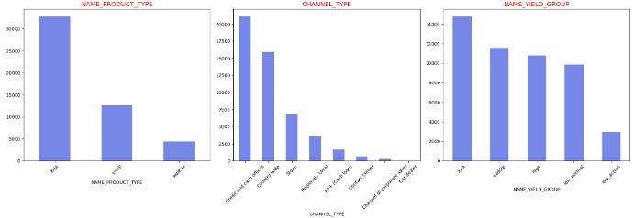
Previous Application
We observe that the column name_contract _type is imbalanced, with consumer loans being much higher than revolving loans. Similarly, the `name_contract_status` shows an imbalance, with a high number of approved applications, while refused and canceled ones are much lower. The `name_payment_type` indicates that cash through the bank is significantly high, while the `code_reject_reason` shows that "aap" accounts for 80%, with eight other reasons making up the remaining 20%. Additionally, the `name_client_type` reveals that repeaters make up 70%. Similar patterns of imbalance are seen in other charts as well.

Slide 24
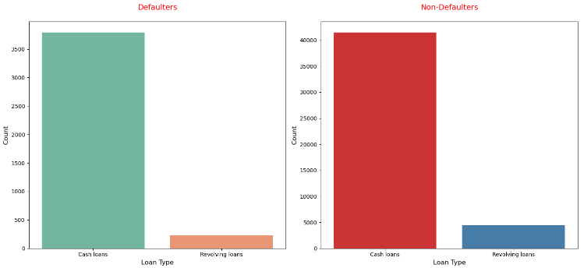
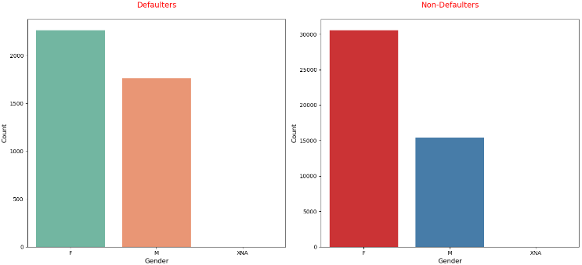
D. Perform Univariate, Segmented Univariate, and Bivariate Analysis:
Univariate Analysis - Dataset 1 :- application_data.csv
Univariate Analysis on categorical columns
In the Loan Type analysis, it is observed that both defaulters and non-defaulters take out cash loans at a rate 8 times higher than revolving loans.
In the Gender analysis, the number of female applicants is greater than male applicants among both defaulters and non-defaulters. For every 10 male applicants, one is a defaulter, while for females, the ratio is 15 to 1, indicating a higher defaulter rate among males compared to females.

Slide 25
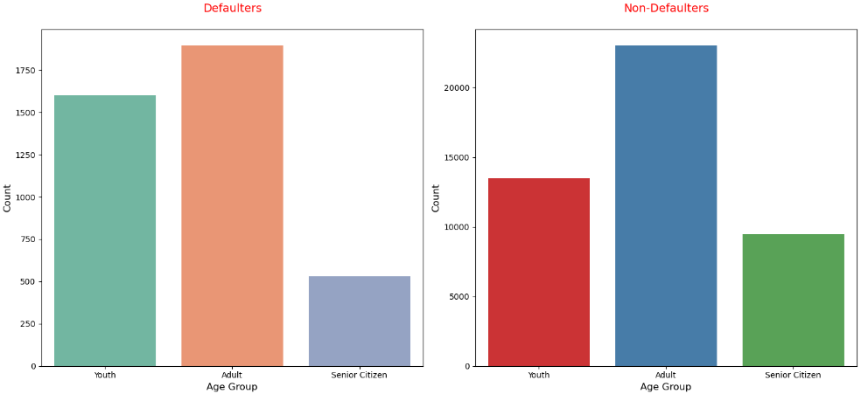
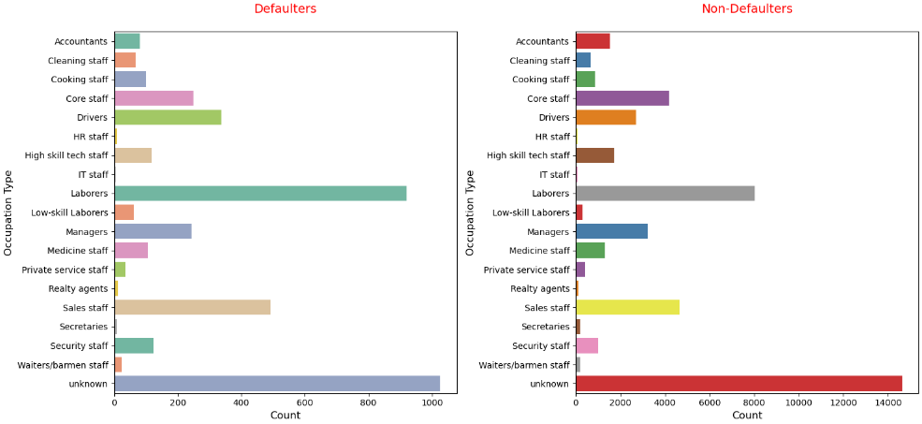
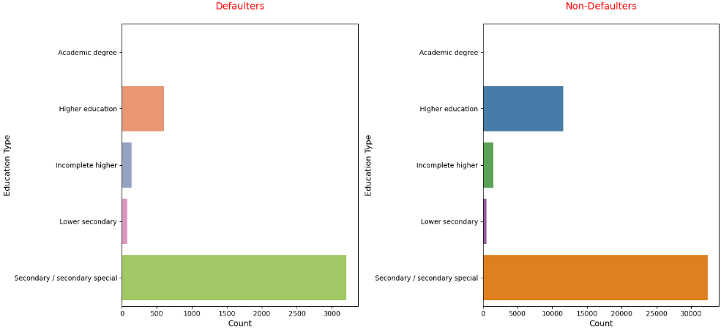
In the Age group analysis, adults have taken more loans overall. Youth have a higher default rate, with 1 in every 8 being a defaulter. Senior citizens have the lowest default rate at 16 to 1, while adults show a default rate of 12 to 1.
In the Occupation type analysis, almost 1/3 of applicants did not provide their occupation so its unknown. Among other occupations, laborers show a default ratio of 8 to 1, drivers 7 to 1, sales staff 10 to 1, while unknown and other occupations have a default ratio ranging between 13 to 15 to 1.
In the education type analysis, around 60% of applicants have a secondary or secondary special education. The defaulter ratio for applicants with higher education is 17 to 1, while for all other education levels, the ratio is between 10 to 11 to 1.

Slide 26
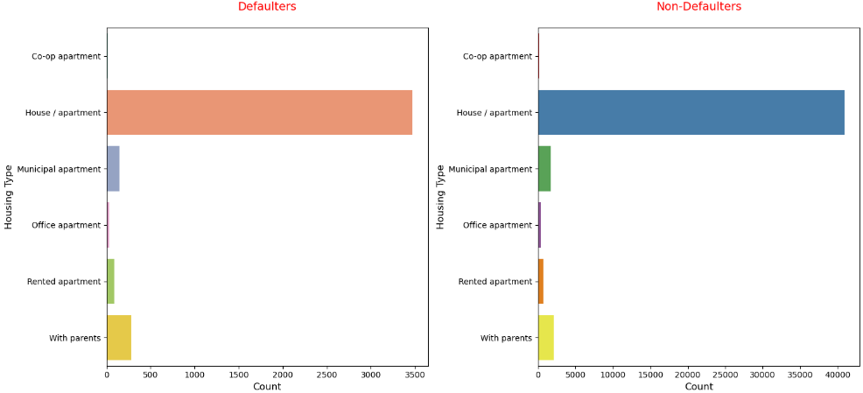
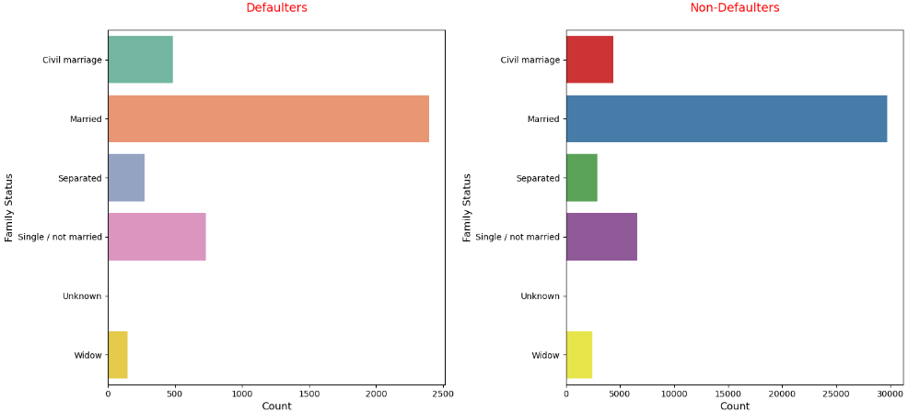
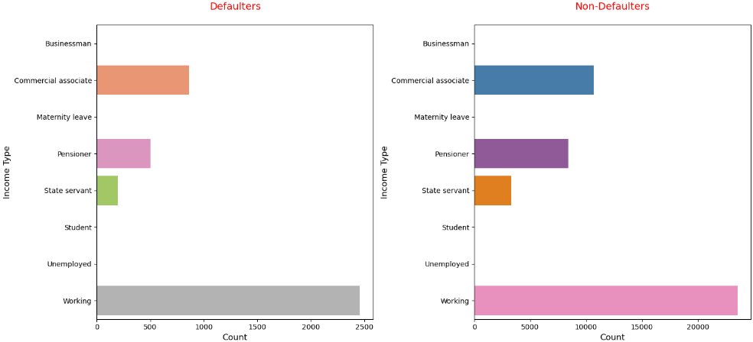
In the housing type analysis, 80% of the applicants live in houses or apartments. Each housing types show a similar default ratio, with approximately 10 to 11 applicants having one defaulter.
In the family status analysis, 60% of the applicants are married, with a defaulter ratio of 1 in 11 to 12. In the single/not married category, the defaulter ratio is slightly lower, at 1 in 10.
In the income type analysis, 50% of the applicants fall under the working category, with a defaulter ratio of 1 in 10. Other income types show a slightly better defaulter ratio of 1 in 11.

Slide 27
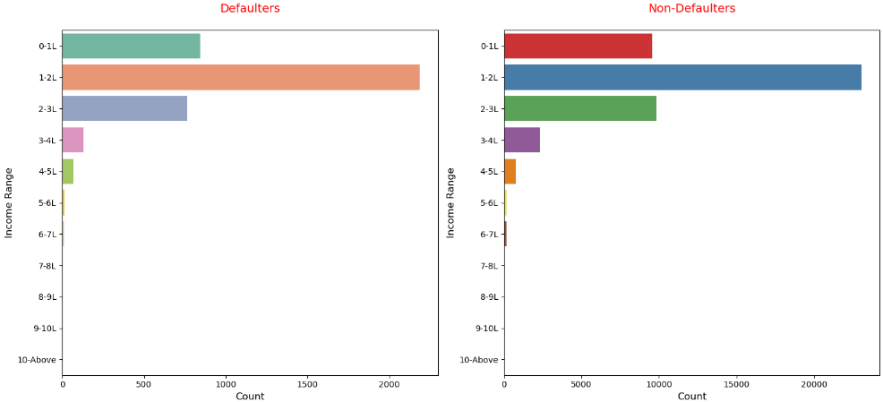
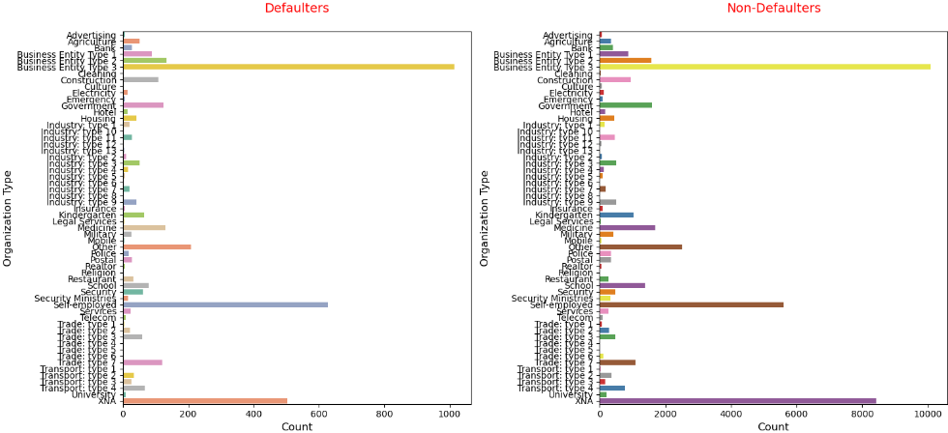
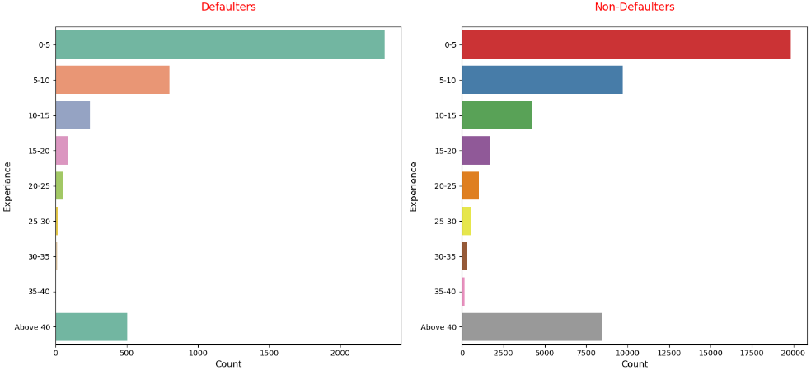
In the income range analysis, 45% of the applicants fall under the 1-2 lack category, with a each range defaulter ratio of 1 in 11. 2-3 lack range has 12-13 in 1
In the organization type analysis, three major organization type: Business Entity Type 3 (20%), self-employed (12%), and XNA (16%). XNA shows a better defaulter ratio of 1 in 16, while other categories have ratios between 1 in 10 and 1 in 12.
In the experience analysis, 40% of applicants have 0-5 years of experience. Appli cants with over 40 years of experience show a defaulte r ratio of 1 in 17,while those with 10-15 years have a ratio 1 in 12. All other experience levels have a defaulter ratio of 1 in 9-10.

Slide 28
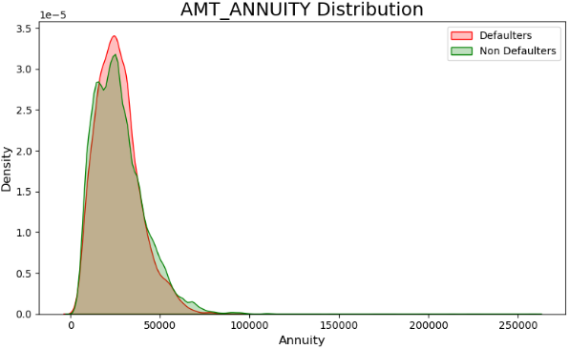
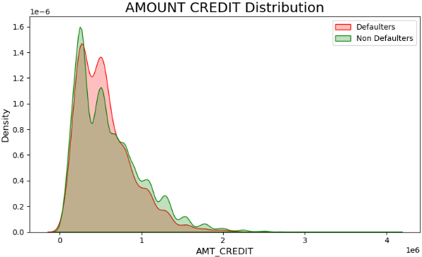
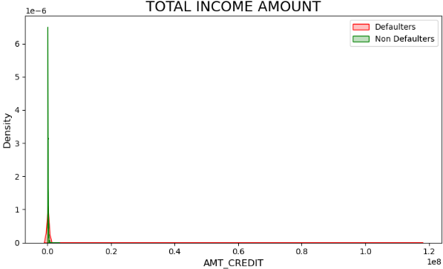
Univariate Analysis on Numerical data
In the AMT_ANNUITY distribution, we observe that the density charts for defaulters and non-defaulters do not show much difference; they appear to be quite symmetrical. This indicates that the annuity amounts for both groups are distributed similarly, with no significant distinction between defaulters and non-defaulters.
In the AMOUNT_CREDIT distribution, we can observe that defaulters tend to reach their peak at lower credit amounts, indicating that defaulters are more common among those with smaller credit. Similarly, in the TOTAL_INCOME_AMOUNT distribution, most applicants fall within the lower-income range, suggesting a potential correlation between lower income and credit issues.

Slide 29



Bivariate Analysis - Dataset 1 :- application_data.csv
The higher the loan amount credited, the higher the annuity, which indicates that AMT_CREDIT and AMT_ANNUITY are positively correlated. Additionally, defaulters are more prevalent in the lower annuity amounts, suggesting a possible relationship between lower annuities and higher default risk.
Similarly, this is shown in AMT_CREDIT and AMT_GOODS_PRICE, which display a linear relationship with little dispersion; as AMT_GOODS_PRICE increases, AMT_CREDIT also increases.
AMT_ANNUITY increases with `AMT_GOODS_PRICE, but the dispersion is notable. For defaulters, the dispersion tilts slightly downward, with lower AMT_ANNUITY values. In contrast, for non-defaulters, the dispersion tilts upward, indicating higher AMT_ANNUITY values.

Slide 30


From the plot of `AMT_CREDIT` and `AMT_INCOME_TOTAL`, we can see that these variables are not correlated, as the plot appears flat, indicating no relationship between them. Similarly, `AMT_INCOME_TOTAL` and `AMT_ANNUITY` also show no correlation, further confirming the lack of any significant relationship between these variables.

Slide 31


In the first box plot, analyzing `AMT_CREDIT` vs `NAME_CONTRACT_TYPE`, we observe that cash loans have some higher credit amounts, while revolving loans are generally lower. In the second box plot, comparing `AMT_CREDIT` vs `CODE_GENDER`, the median credit value for both males and females is roughly the same, around 50,000. In the third box plot, analyzing `AMT_CREDIT` vs `FLAG_OWN_REALTY` (whether applicants own real estate or not), we compare the distribution for "Y" (Yes) and "N" (No). Finally, in the fourth box plot, we analyze `NAME_INCOME_TYPE` vs `AMT_CREDIT`, where we see that business owners tend to have higher credit amounts compared to other income types, which are generally around the same level.

Slide 32


Here we analyze the `NAME_CONTRACT_TYPE` for each gender among both defaulters and non-defaulters. We observe that cash loans are higher overall, and female applicants have a higher loan count compared to male applicants. Among defaulters, the default rate for females is also higher than that of males. Additionally, when analyzing income range, most applicants fall within the range of 0 to 3 lakh, indicating that a significant portion of the population has relatively low income. This suggests a potential link between lower income and higher default rates, especially among female applicants.

Slide 33


Univariate Analysis - Dataset 2 :- previous_application.csv
In this application, the `Name_Contract_Type` for previous loan applications shows that 44% are consumer loans, 40% are cash loans, and 10% are revolving loans.
In this application, the loan status indicates that 60% of applicants are approved, while 20% are either canceled or refused.

Slide 34



In this application, the `Name_Client_Type` shows that 70% of applicants are repeaters—those applying for loans again—while 20% are new applicants.
In the AMT_CREDIT distribution, the density chart indicates that most applicants have low credit amounts.
In the AMT_ANNUITY distribution, the density chart shows that the majority of applicants have annuity amounts around 15,000.

Slide 35


In the analysis of the previous application's loan status across different loan types, we observe that consumer loan applications are mostly approved, with only a few being refused. In contrast, for cash loans, only about one-third of the applications are approved, while the rest are either canceled or refused. Regarding the contract status for client types, we see that most applicants are repeaters, with 50% of them being approved. New applicants also have a relatively good approval rate, indicating a positive trend for both repeat and new applicants.

Slide 36


E. Identify Top Correlations for Different Scenarios
Top correlation in Defaulter Scenarios in application_data : In the top 10 correlated columns, the first two are related to age DAYS_BIRTH and employment DAYS_EMPLOYED, which are strongly correlated due to how they are derived, so we can disregard them. The remaining columns show genuine correlations, such as the strong relationship between AMT_GOODS_PRICE and AMT_CREDIT with a correlation value of 0.99, indicating a near-perfect linear relationship.
Top correlation in No Defaulter Scenarios in application_data : In the top 10 correlated columns, the first two are related to age DAYS_BIRTH and employment DAYS_EMPLOYED, so we can disregard them. The remaining columns show genuine correlations, such as the strong relationship between AMT_GOODS_PRICE and AMT_CREDIT, with a correlation value of 0.99, indicating a near-perfect linear relationship. Additionally, there is a positive correlation between AMT_ANNUITY and AMT_CREDIT, reflecting their direct relationship.

Slide 37

Defaulter heat map correlation columns
In the defaulter heatmap, generated from the application_data dataset, we can observe a correlation matrix where all columns are correlated with each other, represented by varying color intensities. The diagonal line with a full dark color indicates self-correlation, as each variable is perfectly correlated with itself. Additionally, other dark patches in the heatmap indicate strong positive correlations, such as between `AMT_CREDIT` and `AMT_ANNUITY`. The heatmap provides a clear visual representation of the relationships between all columns, allowing us to easily identify significant correlations.

Slide 38

No Defaulter heat map correlation columns
In the non-defaulter heatmap, using the application_data dataset, a similar correlation matrix is generated where columns are correlated with one another. As in the defaulter heatmap, the diagonal line shows full dark color, indicating self-correlation. Other dark areas highlight positive correlations, such as between AMT_CREDIT and AMT_ANNUITY. This heatmap provides a clear view of the relationships between columns, helping to identify strong correlations specific to non-defaulters. Comparing this with the defaulter heatmap reveals differences in correlations across both groups.

Slide 39

Previous application heat map correlation columns
In the heatmap of the previous application dataset, we see 8 columns that exhibit correlations with each other. The heatmap visually represents these correlations, with the intensity of color indicating the strength of the relationship. In the middle of the heatmap, there are around 12 almost dark cells, which represent very strong positive correlations. For example, `AMT_CREDIT` correlates highly with `AMT_ANNUITY`, `AMT_APPLICATION`, and `AMT_GOODS_PRICE`. Similar strong correlations are observed among other columns, making it easier to analyze the relationships between the key financial variables.

Slide 40

Here is the top 10 correlation list for the previous application dataset. The highest correlation is between `AMT_GOODS_PRICE` and `AMT_APPLICATION` with a value of 0.99, followed by `AMT_CREDIT` and `AMT_APPLICATION` with a value of 0.98. This means that `AMT_GOODS_PRICE` strongly influences or is affected by `AMT_APPLICATION`, and similarly, other columns are highly correlated. These correlations indicate how closely related certain features are, and how changes in one may reflect changes in the other.

Slide 41
Results
In conclusion, the project provided valuable experience in handling a real-world dataset by identifying missing data, cleaning the dataset, managing outliers, and addressing imbalanced data through appropriate techniques like imputation. The project also involved performing univariate and bivariate analyses, enabling a deeper understanding of variable distributions and relationships. This process significantly enhanced my ability to use Python for data analysis, particularly in tackling complex datasets with multiple rows and columns.
Additionally, the project helped strengthen my proficiency in key libraries such as Pandas, NumPy, Matplotlib, and Seaborn. Through extensive data cleaning and visualization tasks, I was able to refine my methodologies, gaining more confidence in creating clear, insightful visualizations and implementing efficient data cleaning techniques. This experience has been instrumental in perfecting my data analysis and visualization skills.

Slide 42
Thank you

